Slide 1
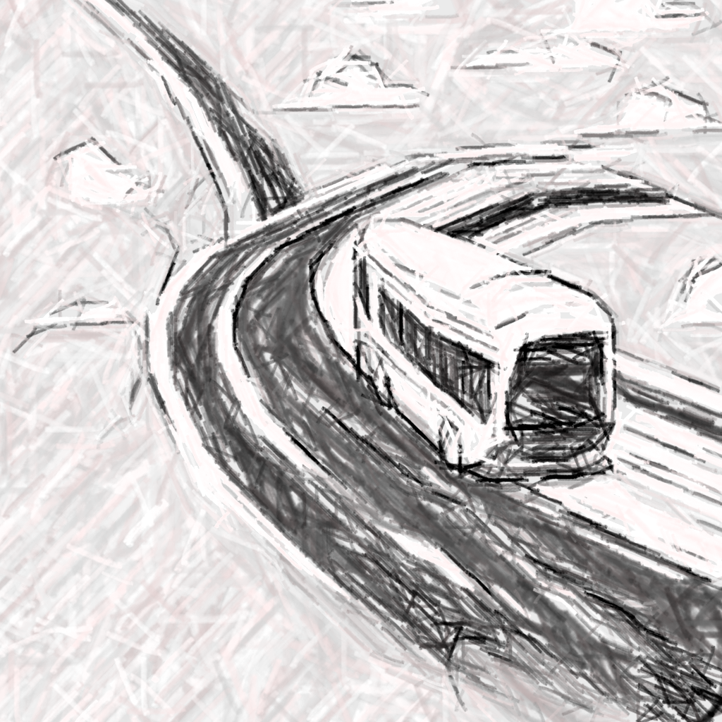

Student Housing - Data for Density and Commute
BY TEAM MUCHACHOS

Slide 2
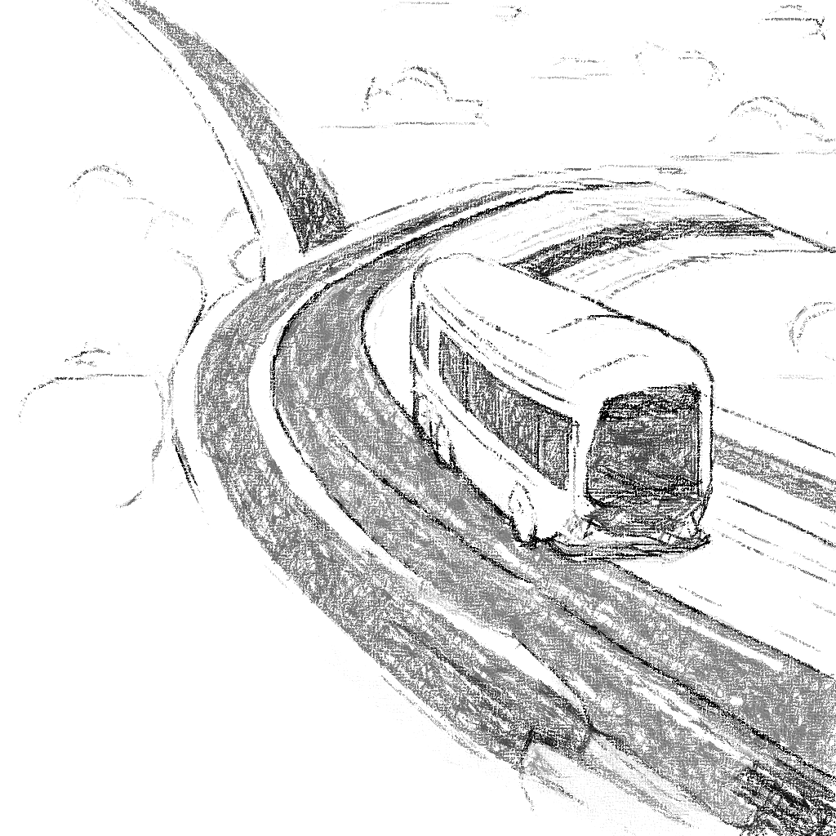


Real Problems need Real Solutions
Long-term Solutions
Immediate Solutions:

Slide 3
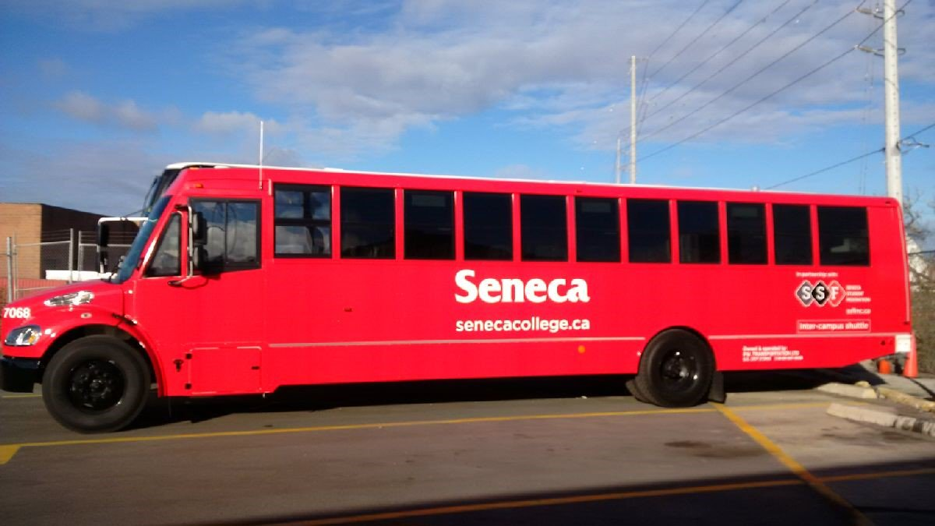
A simple-ready to implement Solution
A new Shuttle Bus Service from Newnham campus to home
Travel 3 times per Week
147 available rooms to rent in the market
At least 20 Rooms per neighborhood
Single - private Room
8
neighbourhoods

Slide 4


Finding the BEST matches
Newnham Campus
North York
Markham
Vaughan
Hamilton
Brampton
Etobicoke
Mississauga
Scarborough

Slide 5
Finding the BEST matches
Vaughan - Mississauga

Slide 6

Finding the BEST matches

Slide 7
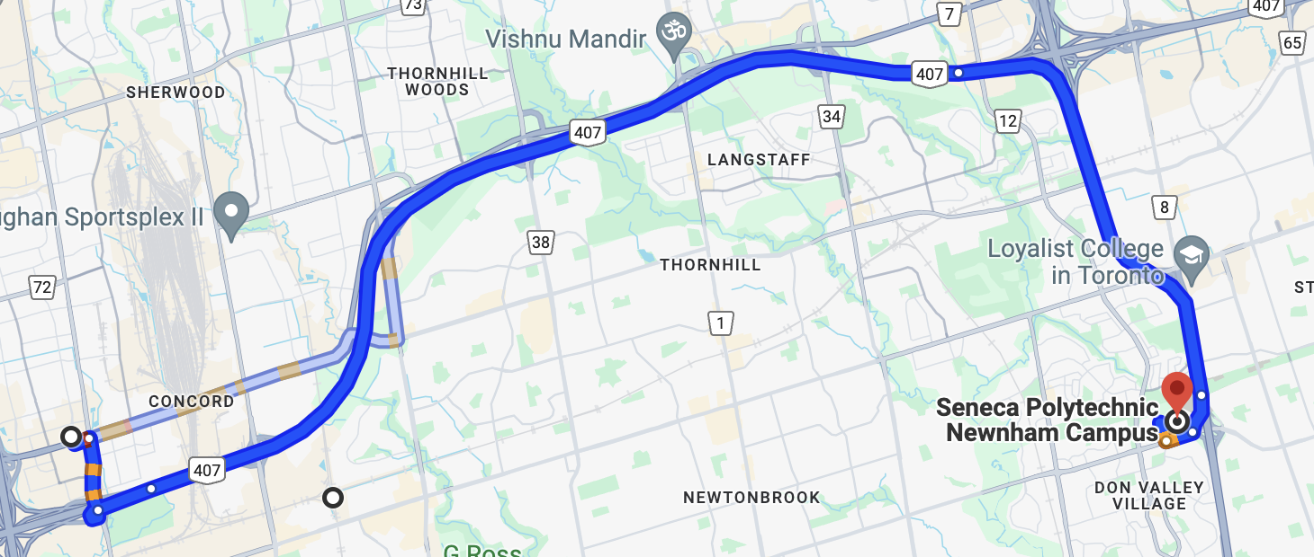
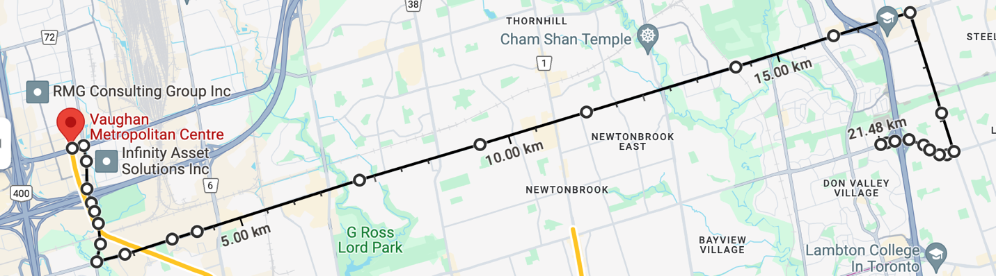

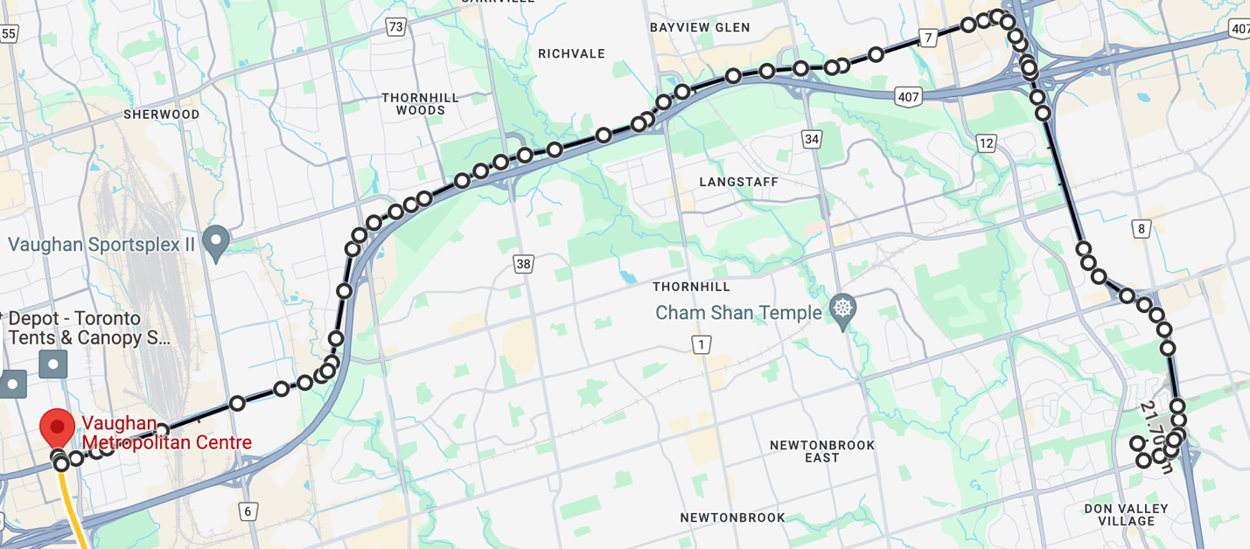
Finding the BEST route - Vaughan
H7
Distance: 22 km
Speed: 70 km/h
Time Range: 35-50 min
Moderate Option
H407
Distance: 23 km
Speed: 100 km/h
Time Range: 30-40 min
Fastest Option
Steeles
Distance: 22 km
Speed: 40 km/h
Time Range: 45-60 min
Slowest Option

Slide 8
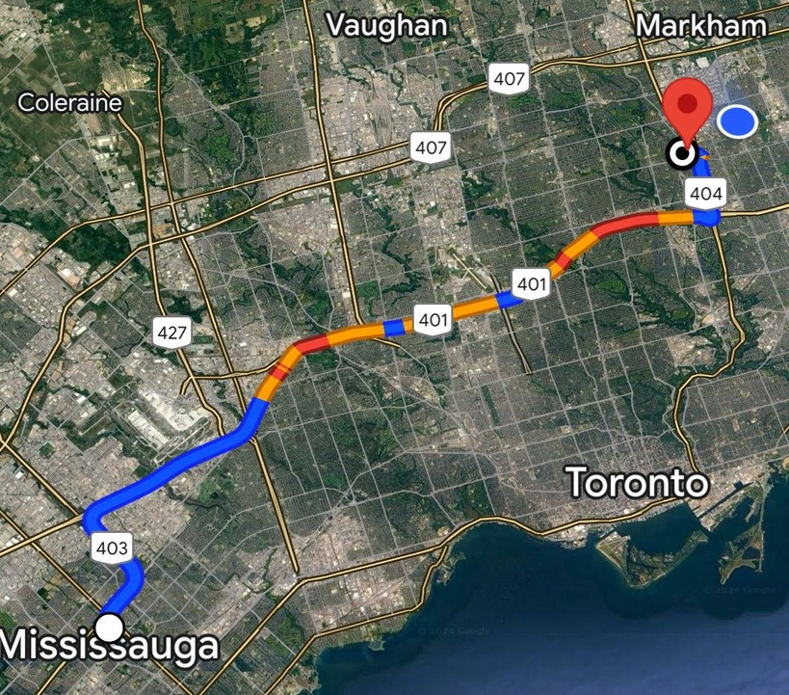
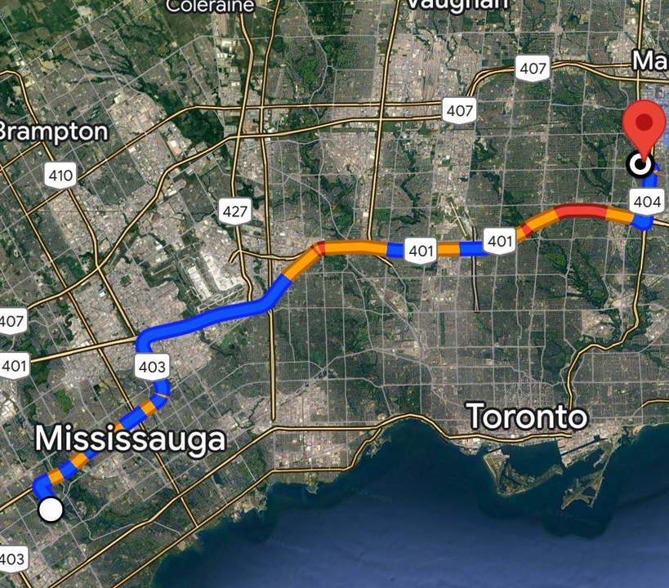
Finding the BEST route - Mississauga
Proximity advantage.
Faster travel.
Convenient transportation options
Close to 401 Highway
Short travel times
Nearby populated areas
Proximity to U of T
Dense population nearby
Longer travel times
Access to 403 Highway

Slide 9
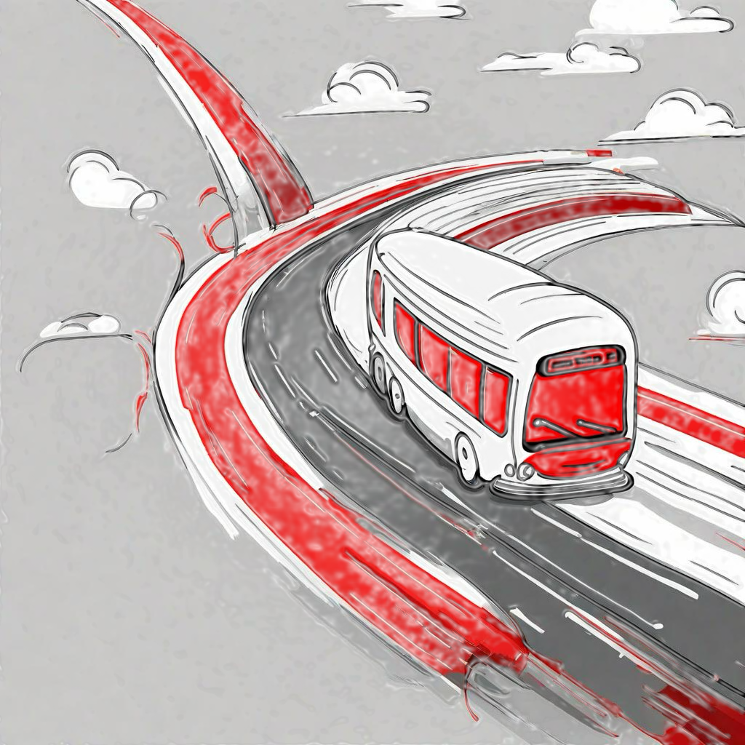
Students
Advantages
Disadvantages
Save money
Have more options to choose were to live
Reduce the number of buses needed
Have a safe travel
Follow the shuttle bus schedule
If you lose the shuttle bus, there is not another one at the same hour

Slide 10
Seneca
Advantages
Disadvantages
Increase the number of students from those neighborhoods
Create more jobs
Have more competitive resources than other colleges
This is a long-term inversion
If this project is not managed properly, it can fail
If students do not use the service, it can fail

Slide 11

Seneca
Local Advertisements
International Advertisements
Seneca now links your Home with your Dream’s Career .
Seneca gives you more opportunities to choose were to live.

Slide 12

Resources needed to be implemented
Only Vaughan - 1 bus
6,700.00 $CAD
Only Mississauga 1 bus
6,800.00 $CAD
Both Neighborhood / 1 bus per Neighborhood
13.500.00 $CAD

Slide 13
Suggested Schedule
1 Bus for the first classes in the morning – 6:45 am
1 Bus at noon to come back home.
1 Bus for afternoon classes – 12 : 45 pm
1 Bus to return home at the end of the day – 7 : 30 pm

Slide 14
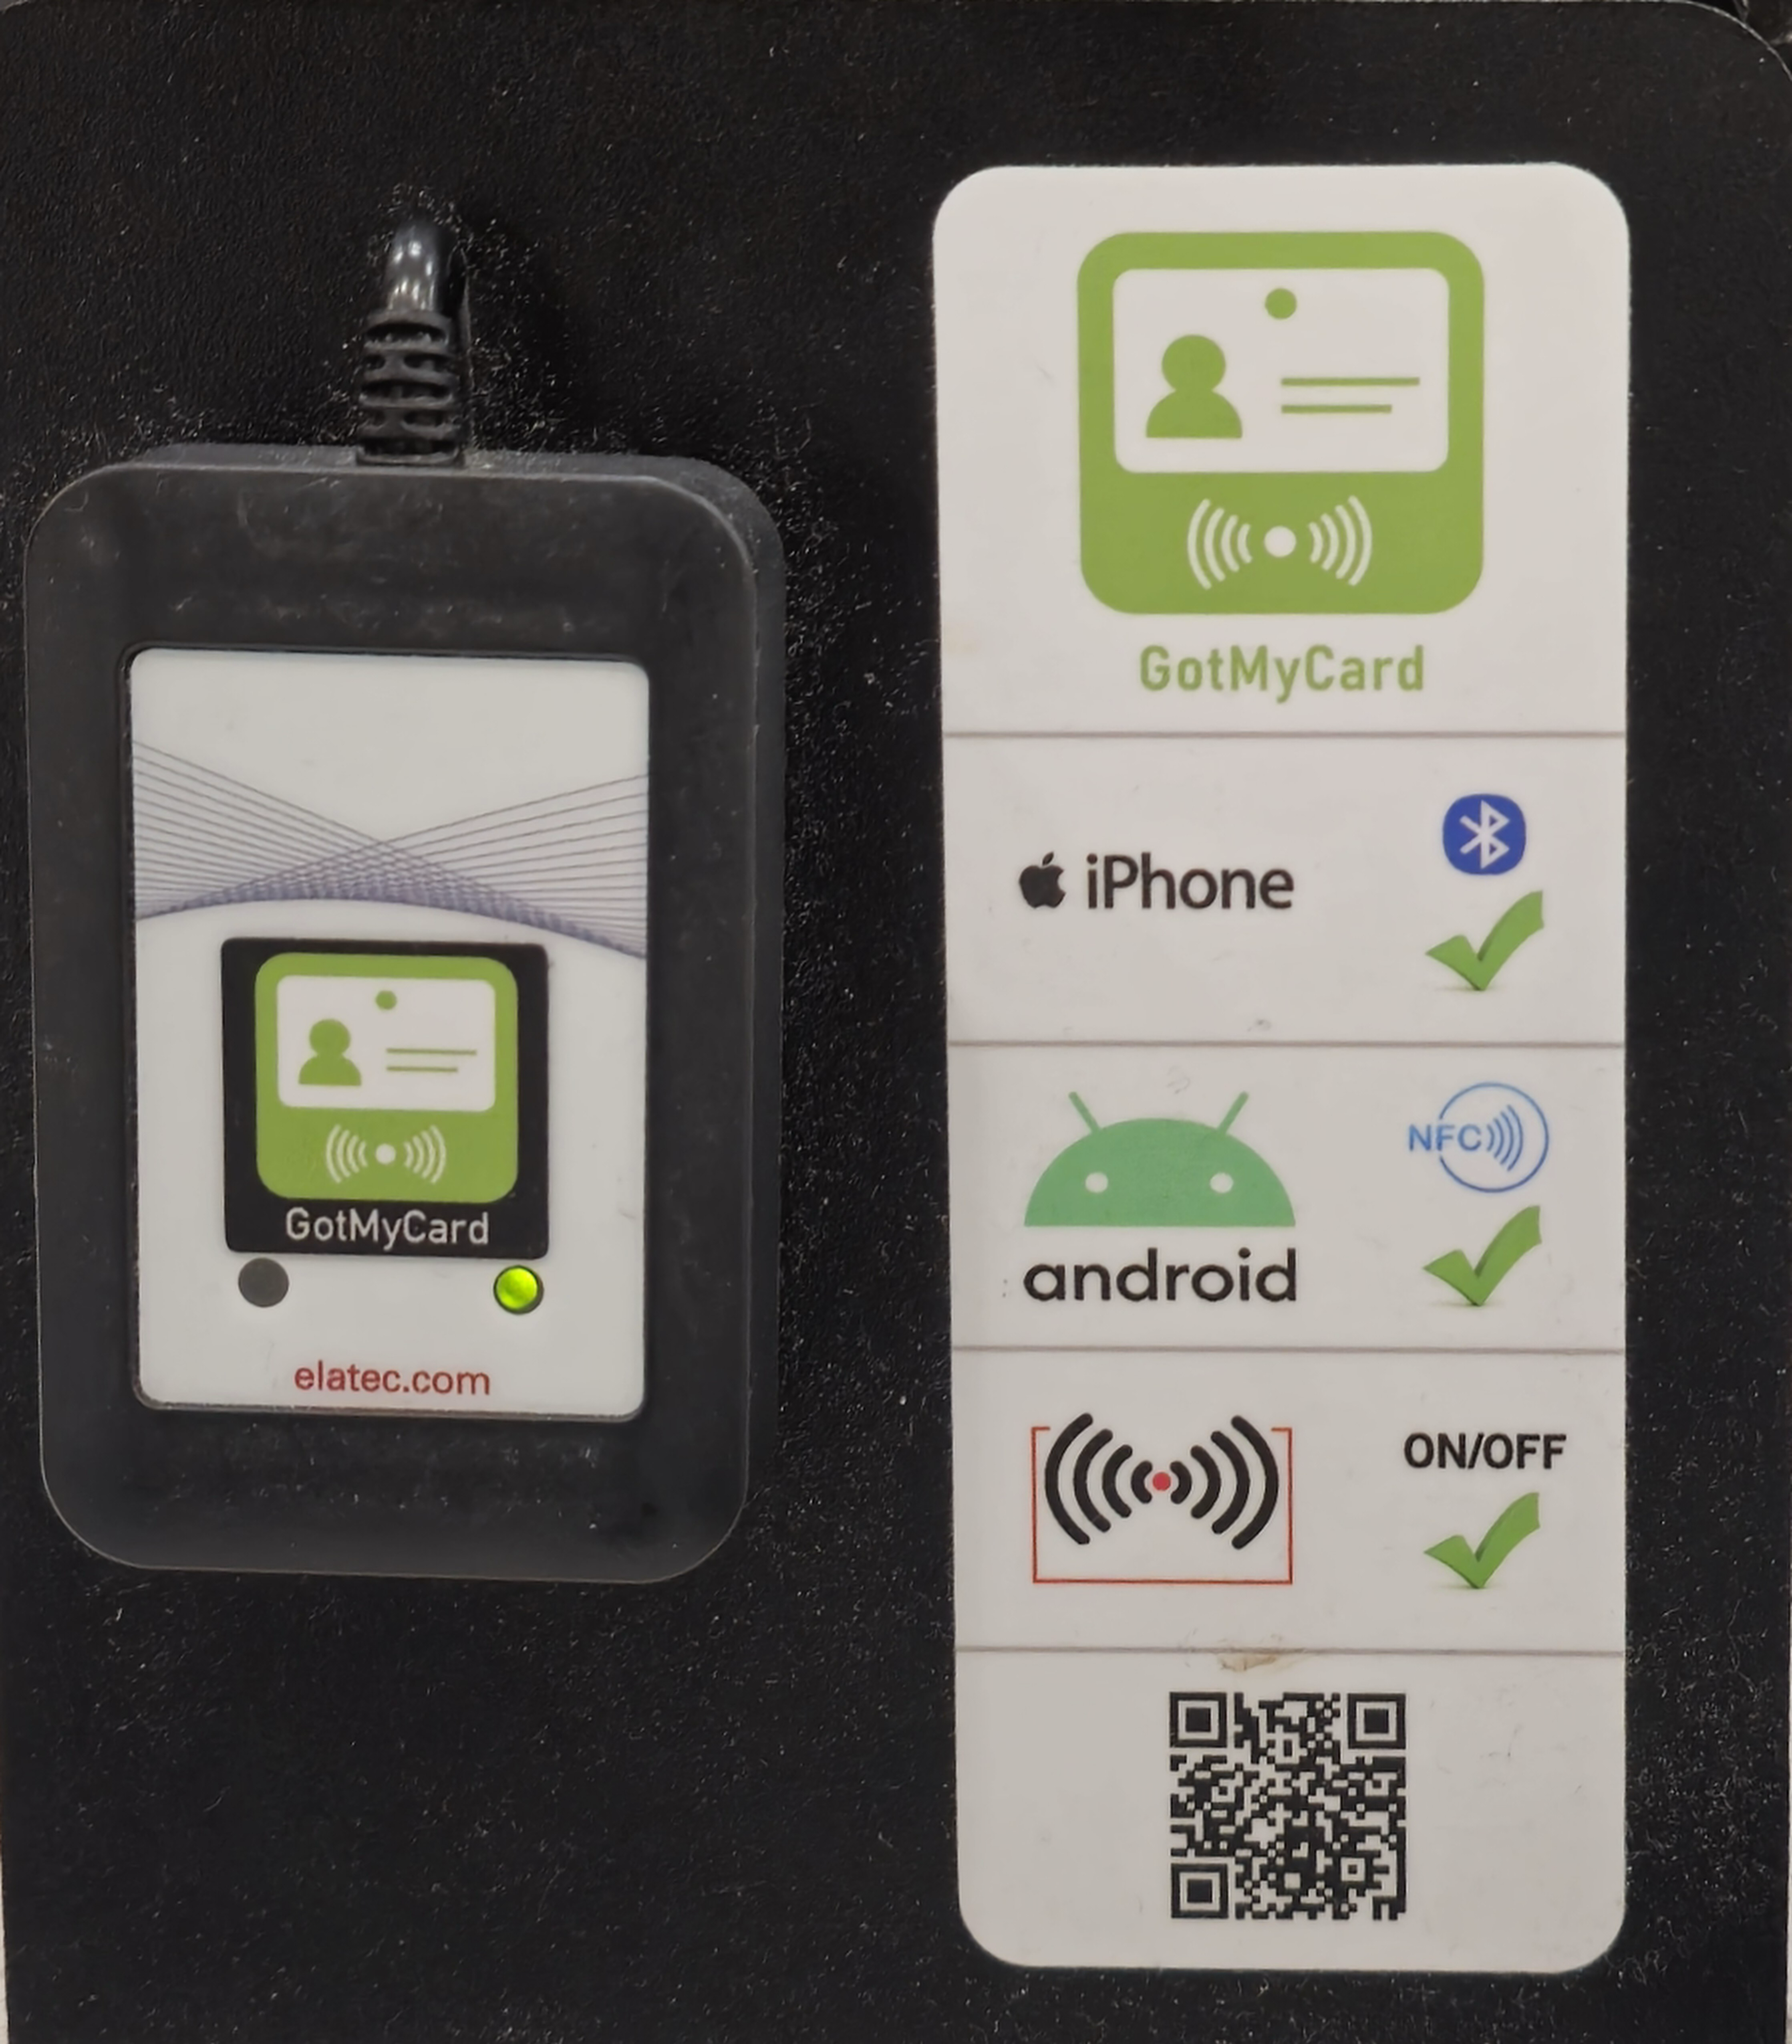


Technology implementations

Slide 15

THANK YOU

